Slide 1
Social Capital Toolkit

Slide 2
Introduction
The Social Capital Toolkit is intended for organizations looking to improve their social impact and enhance their ability to drive positive change in their communities.
Collate, share, and analyze the ideas of 100 Justice, Equity, Diversity, and Inclusion (J.E.D.I.) consultants on contemporary challenges related to diversity and inclusion in organizations
The system will enable 100 JEDI consultants to submit their responses through a wix form, that will be analyzed using AI and ML to identify clusters of ideas and rank them based on their popularity and ideas.

Slide 3
Project workflow
Create Dummy Data
Develop Database
Design ML/AI system
Publish the results

Slide 4
Dummy data
Created 4 tables
Submissions
Questions
Consultants
Themes

Slide 5
Database design
Database creation (MySQL)
Added tables as per referential integrity given by client

Slide 6
MySQL and Jupyter Handshake
Established connection from Python to SQL using JDBC drivers
PyMySQL package integration

Slide 7
Data workflow
Database
Python handshake
Preprocess
Design ML
Deploy ML model

Slide 8
Preprocess the data (dummy text data)
Converted text to array
PorterStemmer and Lemmatizer methods used for converting the words to the roots
Converted to lower case
Remove all the punctuations
Remove stop words
datacamp tutorial

Slide 9
Modelling
Kmeans
LDA - Topic generation

Slide 10
K-means
Using
Using tfidf to convert each word into vector
Determining
Determining the optimal number of clusters (k)
Fitting
Fitting vectors into k means models as per number of k in step 2

Slide 11

LDA
Latent Dirichlet Allocation (LDA): This is a probabilistic topic modeling algorithm that can be used to discover latent topics within a large corpus of text. It can be used to cluster and rank ideas by identifying the underlying topics that they belong to.
Steps Involved in LDA
Clean the data
Preprocessing
Building the model
Optimization
Generate topics
Interpretation

Slide 12
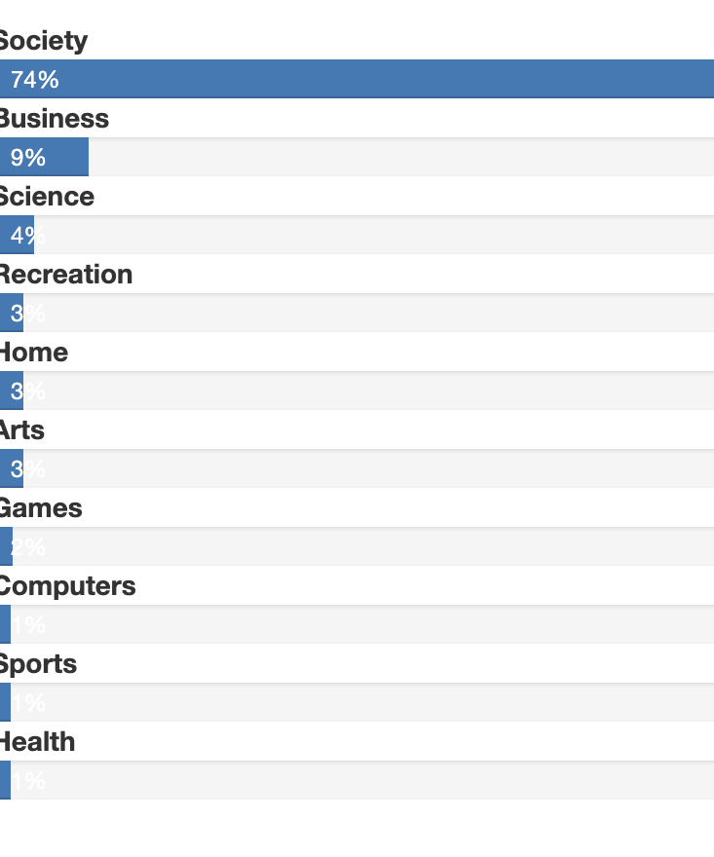
Uclassify API
Open-source API to generate topics
Words in a particular cluster given as input
Getting 10 attributes as output
The output is a probability score of respective topics in a cluster

Slide 13
Deployment
Deploy using the Flask Platform
Files created are
Model.py(ML model)
Flask get and post methods
App.py(Flask application)
Index.html (for input)
Data file
Result.html (for output)

Slide 14
Thank you

